Slide 1
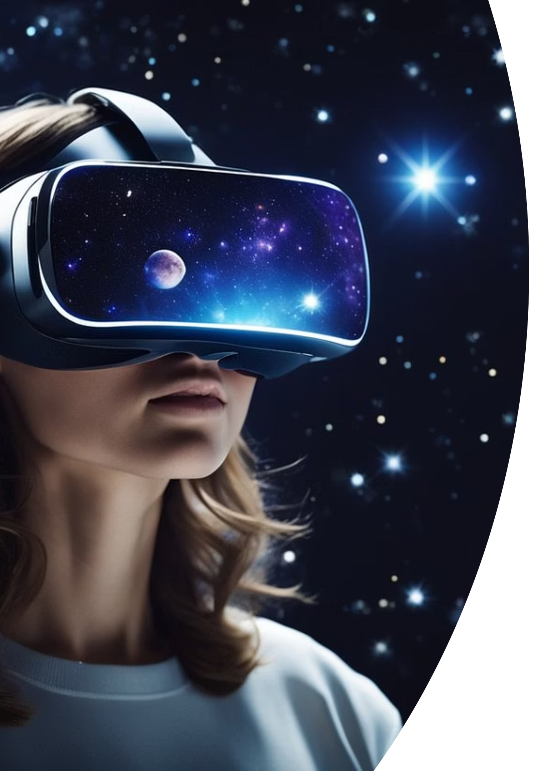
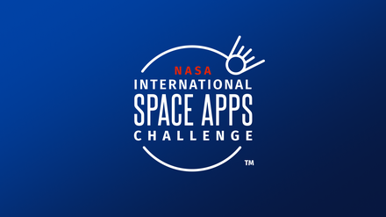
Space Exploration
with Virtual VR
By Team Optimax
Team Members:
Hard Bosamiya
Riya Panchal
Vaishali Saini
Vishwa Patel
Saraswati Chauhan
Affiliation:
L.J. University, Department of Computer Science
NASA Space Apps Challenge 2025

Slide 2
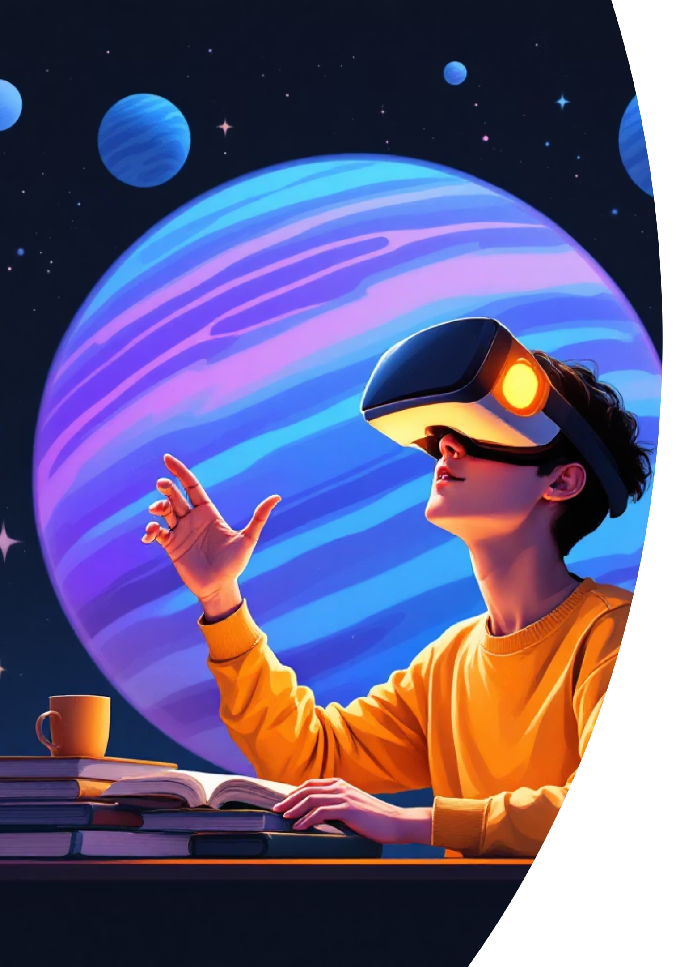
The Challenge We're Solving
The Problem
Our Solution
Middle school students—especially in 6th and 7th grades—often struggle to grasp space concepts like planets, moons, constellations, and the solar system through textbooks and flat diagrams alone.
We've created a Virtual Reality platform using Unity that transforms space education. Students can now:
Walk through the solar system in immersive 3D
Zoom into planets and moons to explore surface features up close
Space is three-dimensional, vast, and dynamic, but traditional classroom tools can't capture this scale and depth. This leads to learning gaps and declining interest in astronomy.
Visualize constellations in a realistic night sky
Learn through interactive animations and clear narrations
In short: A space classroom in VR!
NASA Space Apps Challenge 2025

Slide 3





Key Features That Make Learning Come Alive
3D Models
Animations & Narration
Immersive VR Experience
Detailed, accurate 3D models of planets, moons, and constellations.
Engaging visual storytelling with clear audio explanations.
Powered by Unity, compatible with Oculus and other VR headsets for true presence in space.
Grade-Appropriate Content
Scalable Platform
Content designed for 6th–7th grade students, matching curriculum standards.
Built to expand with more astronomy topics, missions, and interactive experiences.
NASA Space Apps Challenge 2025

Slide 4
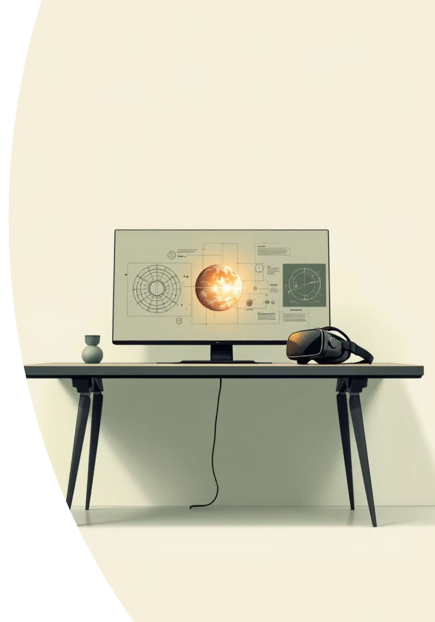
Technology stack
Unity Engine (C#)
1
Unity Engine powers our VR development, enabling smooth animations and seamless interactivity.
NASA Open Data
2
Authentic NASA open data ensures scientific accuracy and real measurements for planet textures and astronomical information.
OpenXR Standard
3
Built on OpenXR, our platform offers maximum compatibility across all major VR devices.
3D Modeling Tools
4
High-quality 3D modeling tools and assets create stunning, immersive space environments.
NASA Space Apps Challenge 2025

Slide 5
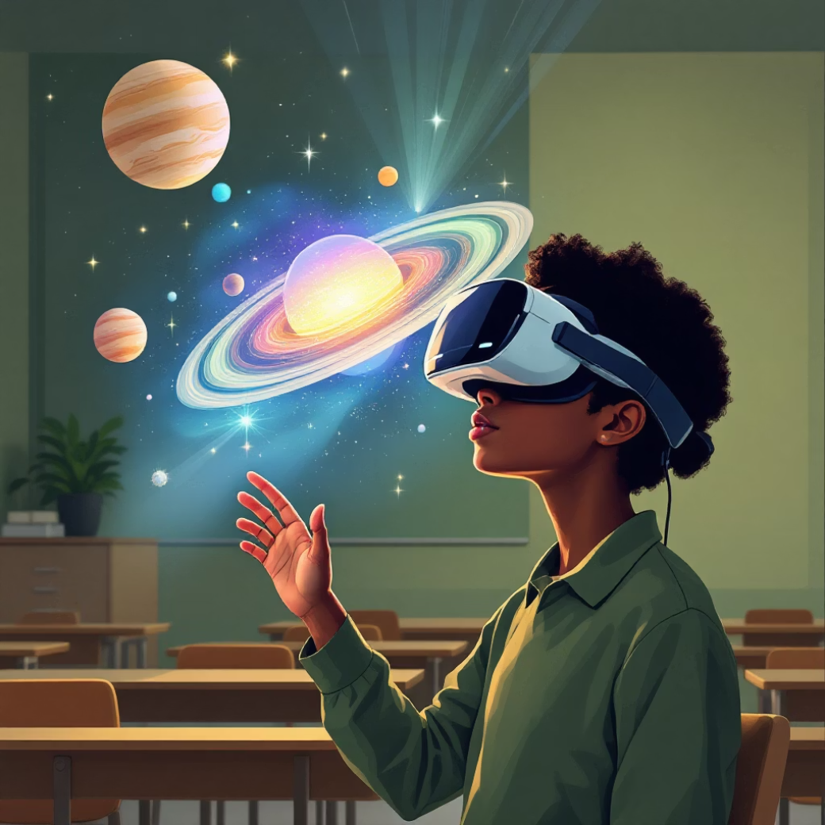
Real Impact on Education
Bridges Learning Gaps
Students grasp complex astronomical concepts faster and retain knowledge longer through interactive 3D exploration.
Ignites Passion for Science
VR transforms abstract topics into exciting adventures, inspiring STEM
careers.
Empowers Educators
Teachers gain a powerful tool that makes lessons engaging, visual, and
memorable.
Supports NASA's Mission
This aligns with NASA's vision to build space exploration awareness and inspire the next generation of scientists.
NASA Space Apps Challenge 2025

Slide 6

Our Vision for the Future
"We are bringing the universe into the classroom—making space education immersive, interactive, and inspiring for the next generation."

Slide 7
Output
Link :- https://github.com/HKgaminghub/Space-exploration-using-vr/edit/main/README.md

